Slide 1

Oodles of Data, Gallons of Knowledge and an Ounce of Wisdom
I know it sounds cringey!! But its cool how much data is out there and how empowering it can be, to know where to look and what to look for!
After this class, you will be pros in filtering, sifting, and critically analysing information out there
School research will never be the same if you apply this OGOz lens!

Slide 2
There’s so much out there! How do you know what's good?
You can't manage what you can't measure – Peter Drucker
See below why GDP does not us the full story
https://www.project-syndicate.org/commentary/new-metrics-of-wellbeing-not-just-gdp-by-joseph-e-stiglitz-2018-12?barrier=accesspaylog

Slide 3
Measurement vs. metric
Measurement is “What you want to measure to understand some thing’s position, status, or condition” for e.g., speed = distance covered vs. time
Metric is “how you will represent it?” for e.g., representation depends on the context of the measurement, but uses Standard scale and repeatable technique
For example, internet speed is most commonly represented in megabits per second (Mbps)
Average Speed of a car is represented in miles/kilometres per Hour (Mph/KmPH)
Now give me something you want to measure and tell me how you would measure it?
I give this: I want to measure Customer Satisfaction and I could use “Times visited per Month” as a metric
Tell me one fallacy in the above metric

Slide 4
Understanding how to look at data
Data can be related or unrelated – think trade wars and price of your coffee – are they related? But does one cause another? May be/May be not.
Think: Correlation Vs. Causation – Question to ask: Does this cause this? Or are these correlated but don’t cause each other?
Deeply understanding relationships of pieces of data is what research does best – in computing world Artificial Intelligence and Machine Learning promise us breakthroughs via this ability. Statistics, Mathematics, Cognitive Sciences are all used in the process.
  Cardinal – the number or count of the item
  Ordinal - the position of the item in the list also known as ranking order
  Nominal – the name of the item in a certain position
  Interval – distance between two observations – does not have a fixed point
  Ratio - relative measure with reference to a fixed point i.e., Zero

Slide 5
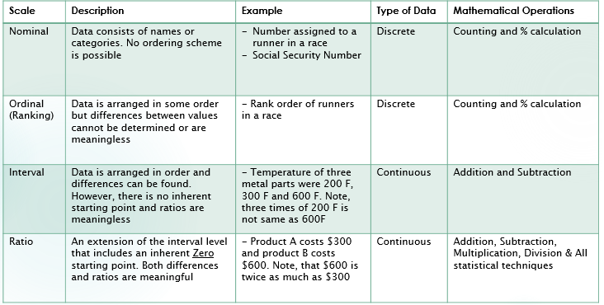
Tables are good!
Here’s a great reference from https://sixsigmastats.com/learn-data-types/

Slide 6
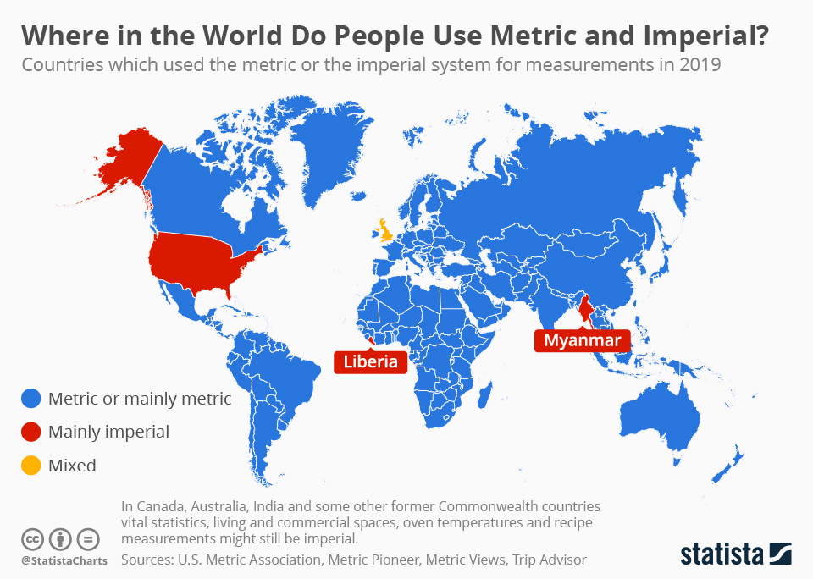
Difference?
Funny, but true, most of the world uses a Metric system of measurement i.e., in Kilograms, meters, liters etc.,

Slide 7
Benchmarking and Key indicators
What we measure affects what we do, and if we measure the wrong thing, we will do the wrong thing. – Joseph Stiglitz
Key Performance Indicator: Not all Metrics are KPIs but all KPIs are metrics that measure something
Some of these metrics could be used as the “gold standard” aka “Benchmark” that we can use to compare future results.
So when does a Metric become a KPI?
  Only when the metric matters so much that you are ready to invest a lot more resources and efforts into getting it go go higher or do better! That’s when it becomes a “Key” Performance Indicator!

Slide 8

Let's get to work!

Slide 9
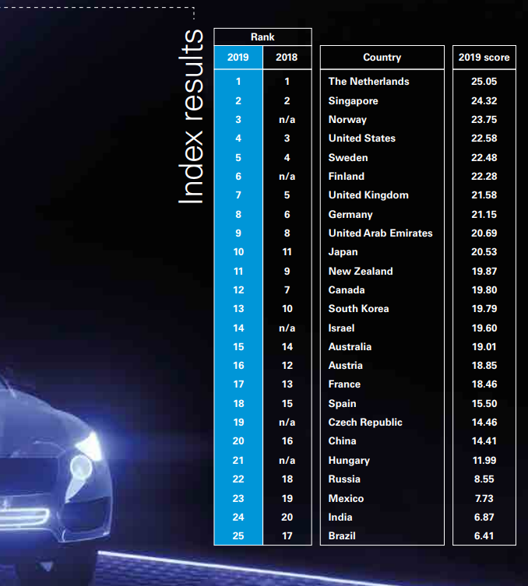
Autonomous Vehicle Readiness Index
https://home.kpmg/xx/en/home/insights/2019/02/2019-autonomous-vehicles-readiness-index.html

Slide 10
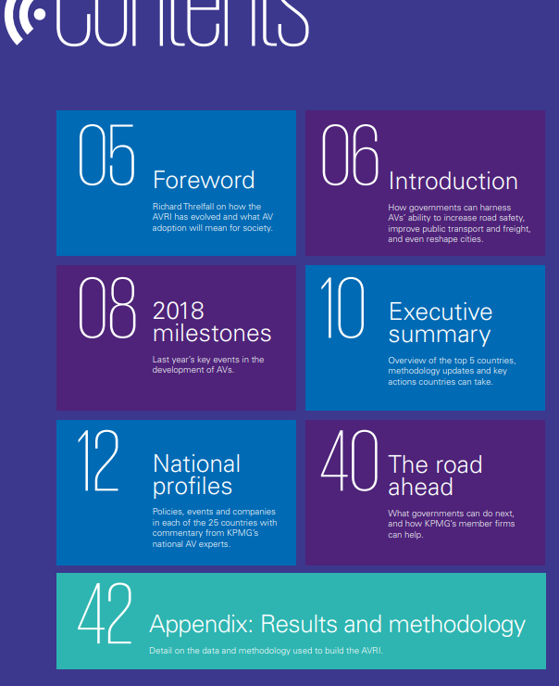
Study methodology of the report
When you look at report, don’t just look at the ranking or the outcome – Probe further!
Ask “How did they find out? What did they look at?
The Appendices usually are the most important parts of any report – Go there first after you see the summary!
Methodology will tell you how they drew that conclusion and if it is applicable to your case?

Slide 11
Why is this important?
Well, for one, Humans are not Perfect. Humans are not rational!
Is that a statement? Is it true? Should you believe me? No you shouldn’t!!
Research for yourself! And Study Cognitive Sciences to learn more in-depth if you like thinking about this!

Slide 12
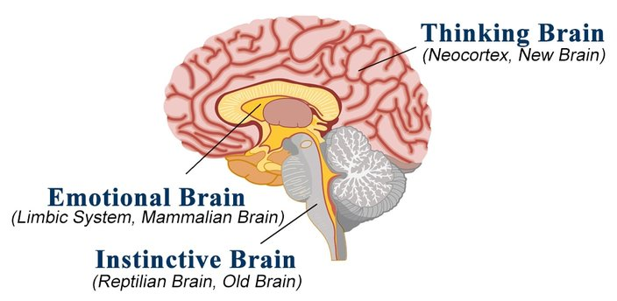
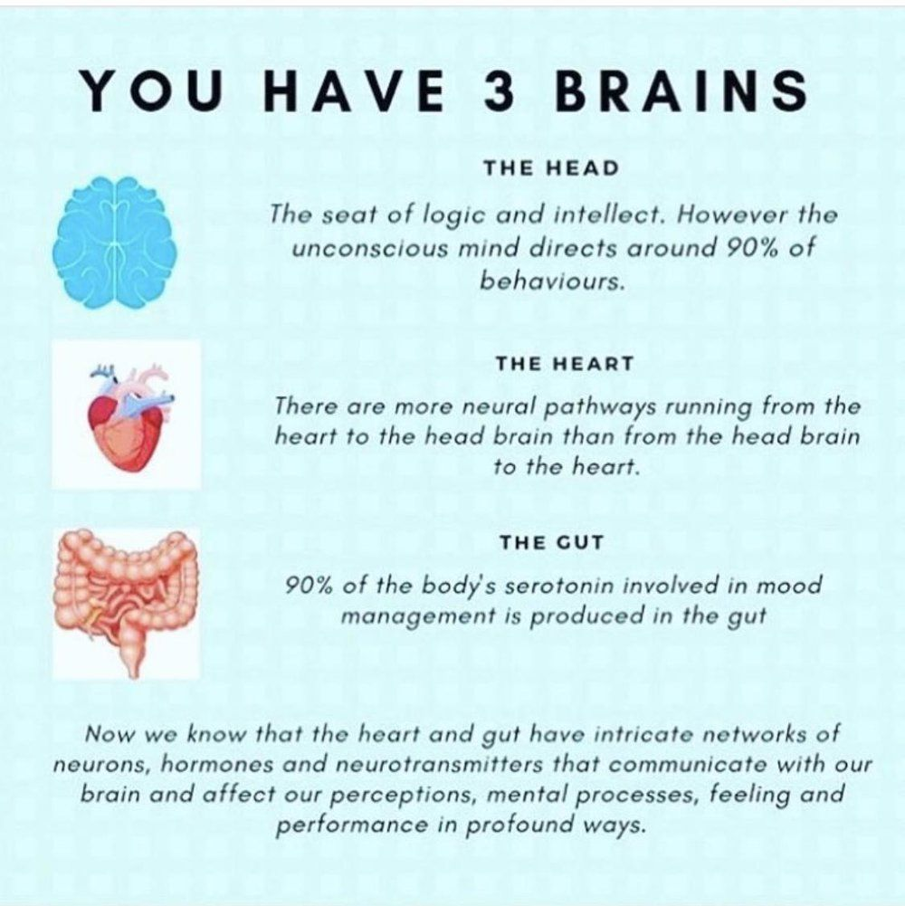
3 brains, three times the power to think better!
What you eat impacts your brain(s)!!

Slide 13
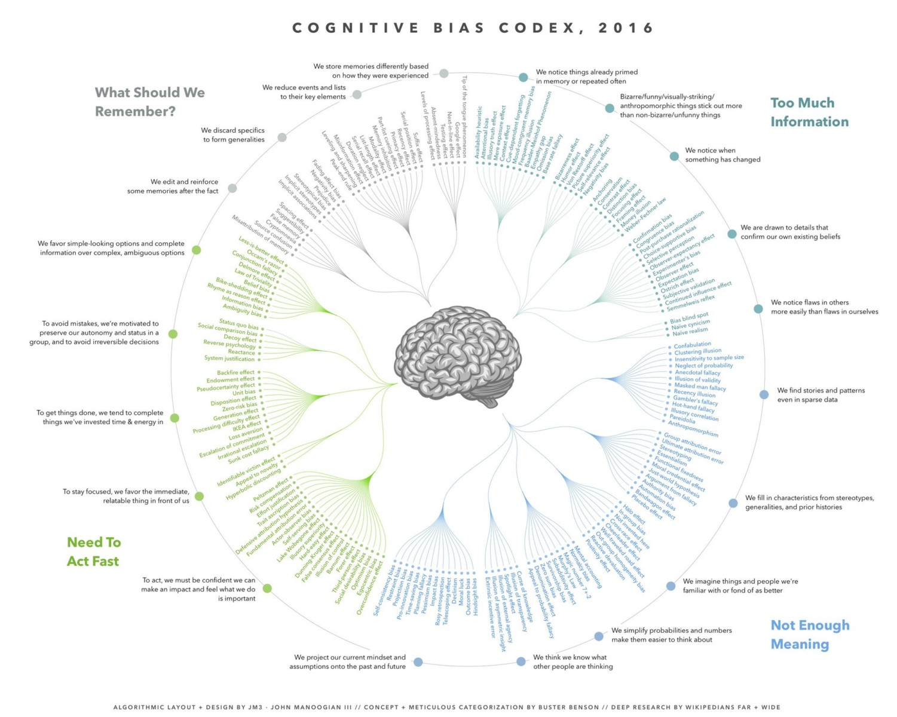
Bias Codex
https://ritholtz.com/2016/09/cognitive-bias-codex/

Slide 14
Sample quality matters – selection bias
Happens when you tend to look at a sample that are not truly and wholly representative of the population – meaning we “chose” the weak examples to prove our point
May happen unintentionally – again, because Humans are not perfect
You can avoid it – by ensuring you look at the problem from several different angles, choose examples from a wider variety of samples and variety of factors to judge a situation, not cherry-picking and instead randomize the selection process among many other techniques!
Love this? Go ahead and explore Statistical Methods to learn more about how to do qualitative and quantitative research!!

Slide 15
Sample size matters – fallacy of small numbers
Just because we saw something in a small group of sample does not mean we will see that if the sample size were to be scaled to a larger size.
Assuming that this will apply – is the fallacy!
For e.g., in a sample of 100 marbles, the odds of picking all blue is higher whereas in a smaller sample that odds decreases and you have more chance of picking a blue
Ex2: In a group of 10 people you have less chance of someone knowing how to knit, perhaps in a bigger sample, the chances of finding people who know how to knit are higher!
Moral of the story? Just because we found no one who knew how to knit, we cannot conclude that Cantabrigians don’t know how to knit!!

Slide 16
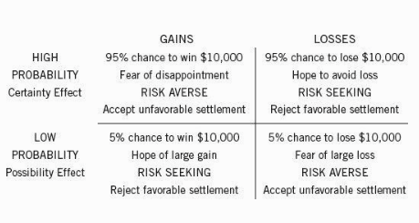
Four-fold pattern – Prospect Theory
Want to explore more?
Well then, you should study Behavioral Sciences or Behavioral Economics!
Some good books for the holidays?
Thinking Fast and Slow, by Kahneman
Predictably Irrational, by Dan Ariely

Slide 17
Whirlwind tour of the data in the web!
Lets look at some real indices/reports/metrics that tell us a lot about the world we live in!

Slide 18
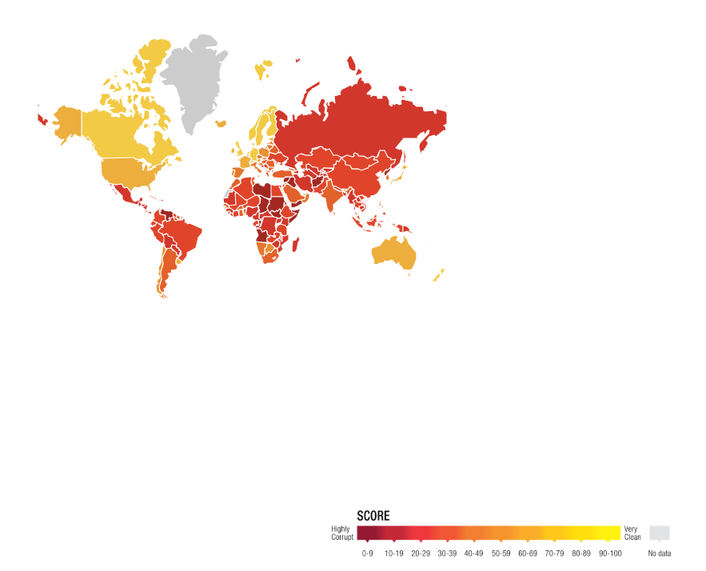
Corruption Perception Index
https://www.transparency.org/cpi2018

Slide 19
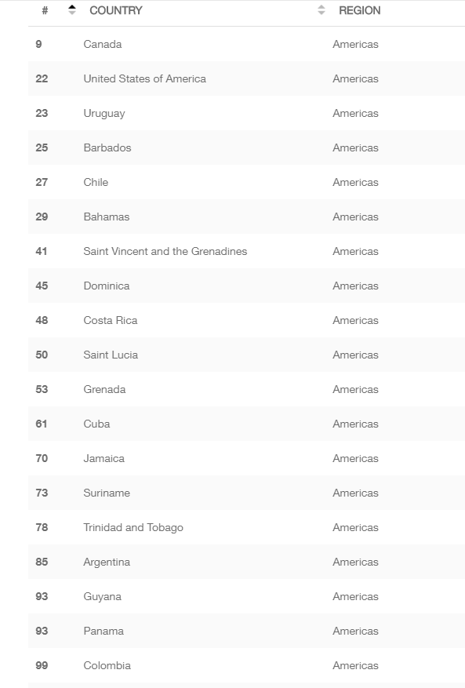
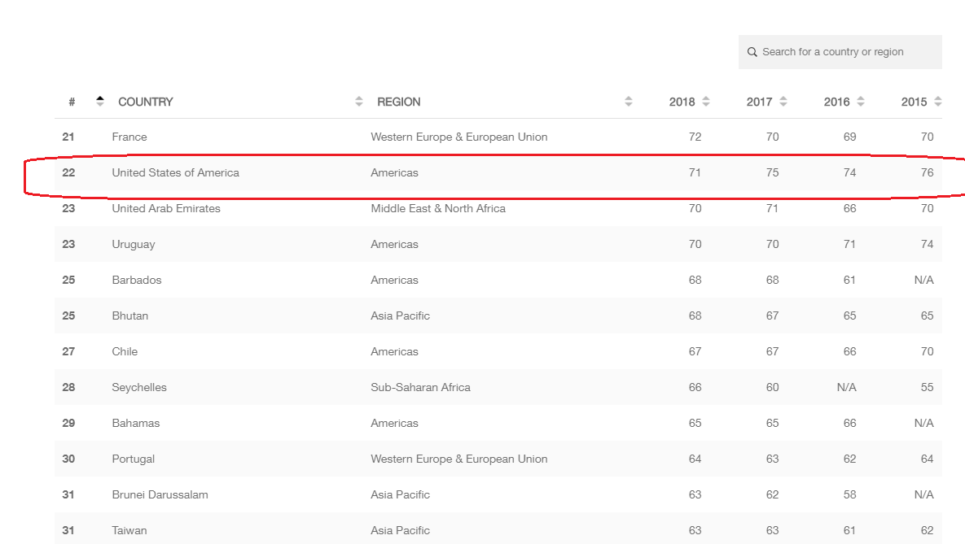
Where Do We Stand?
22nd In the World Ranking And 2nd In the Americas

Slide 20
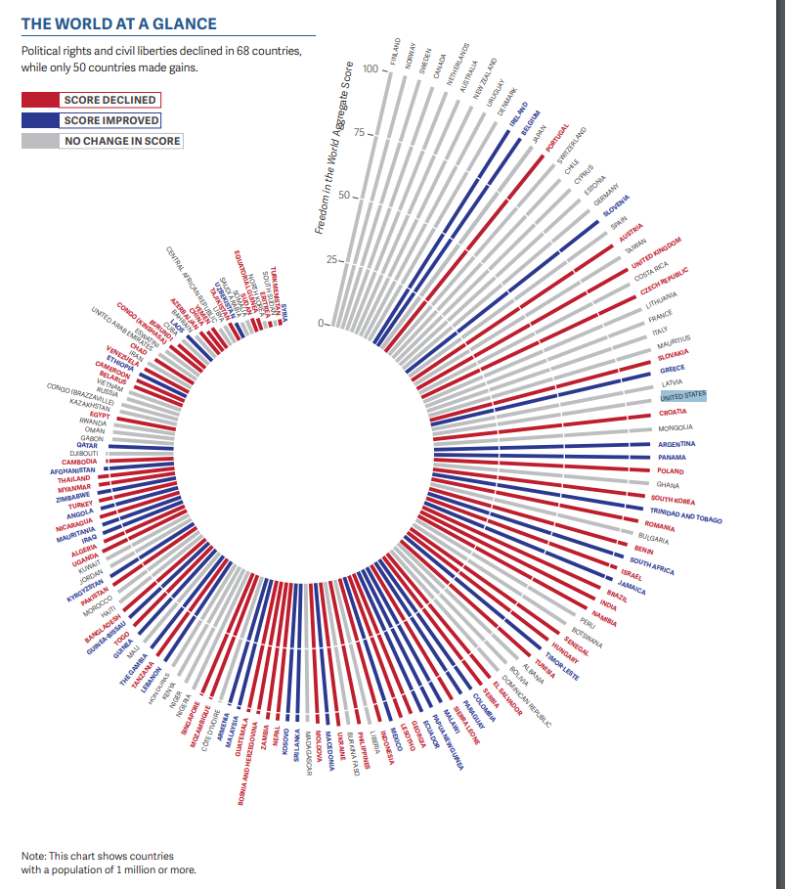
Freedom In the world report
https://freedomhouse.org/report/freedom-world/freedom-world-2019

Slide 21
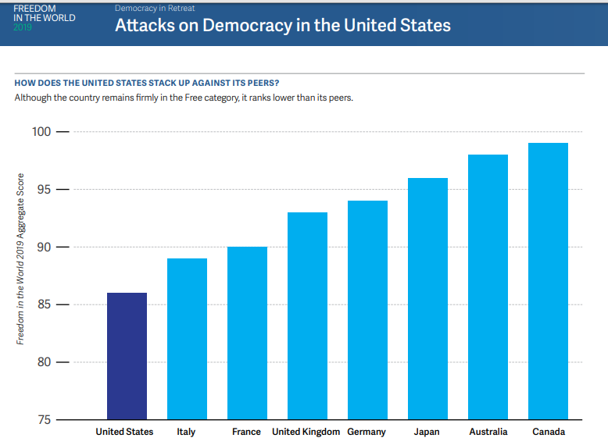
Where do we stand?
Here’s where we stand compared to our developed peers in the world

Slide 22
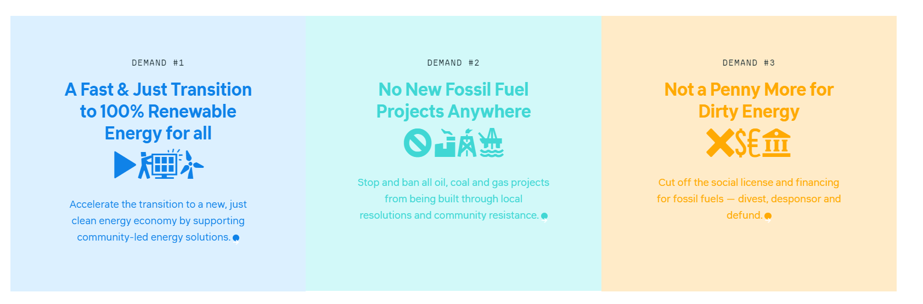
Global Divestment Campaign
https://gofossilfree.org/about/

Slide 23
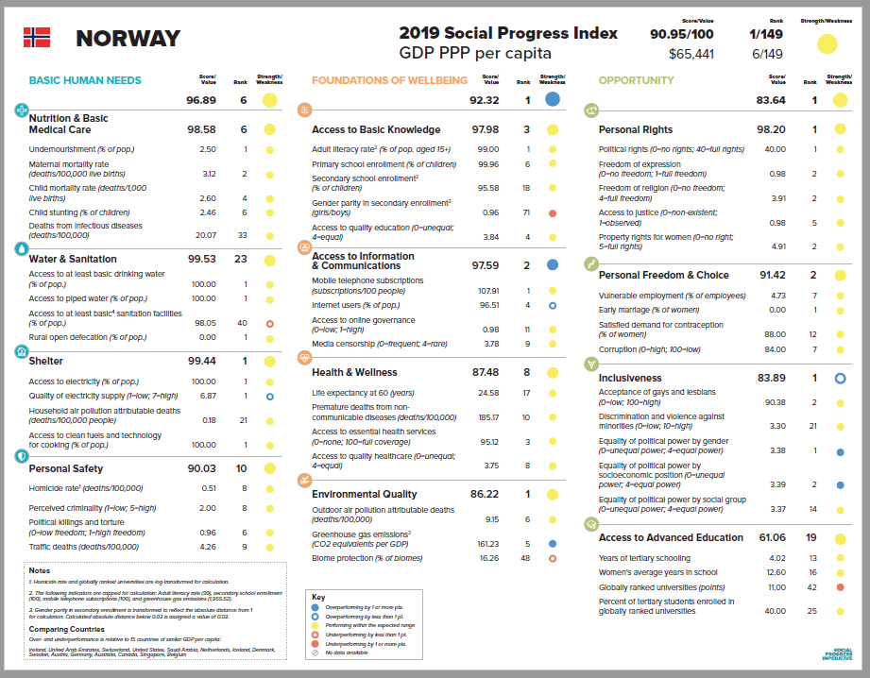
Social progress imperative
https://www.socialprogress.org/

Slide 24
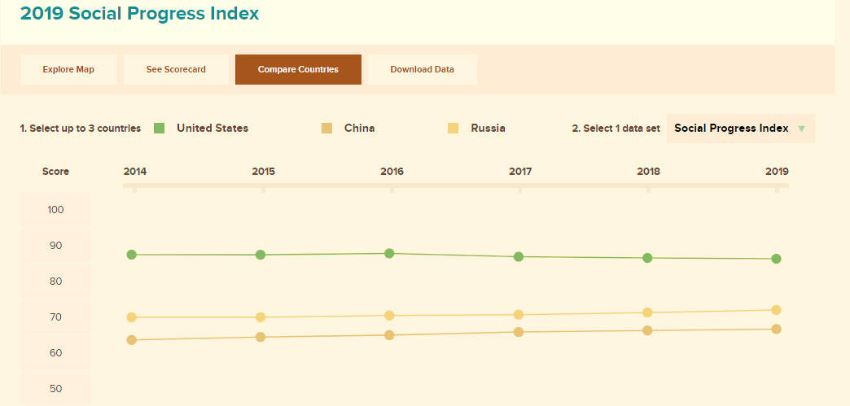
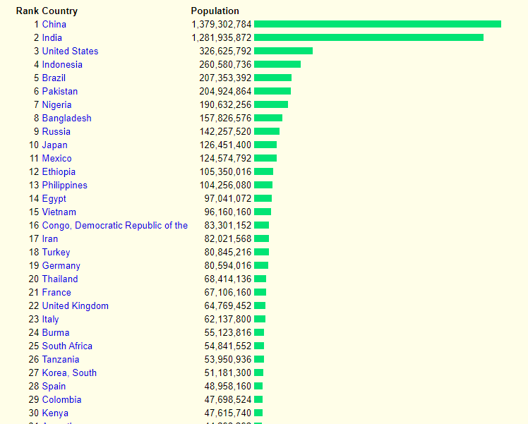
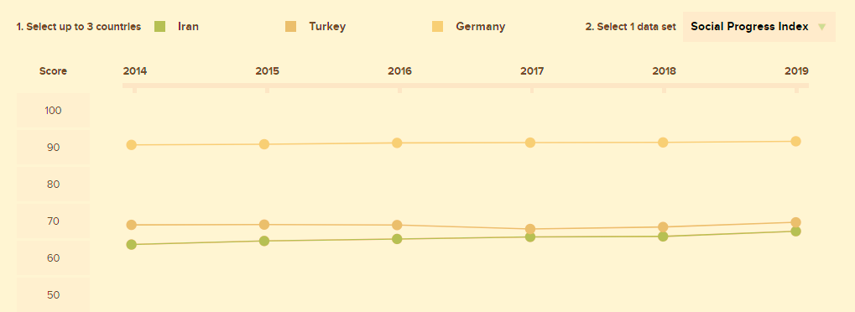
Looking at data!
Depends on how you want to show it
Positive spin – you tend to compare with weaker ones
Negative spin – you compare with better ones
Neutral spin – compare apples to apples – pick a common factor: In this case, I chose population size as my factor to compare
Iran, Turkey, and Germany all have similar population if you see the green graph on the slide

Slide 25
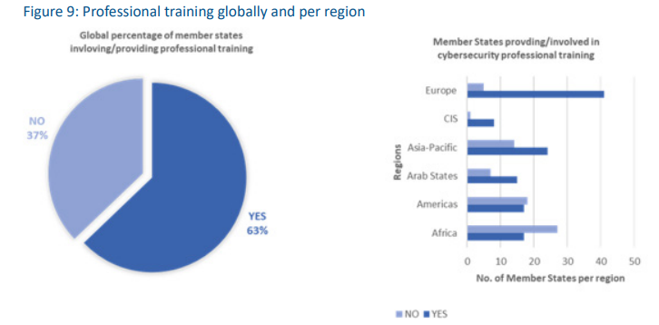
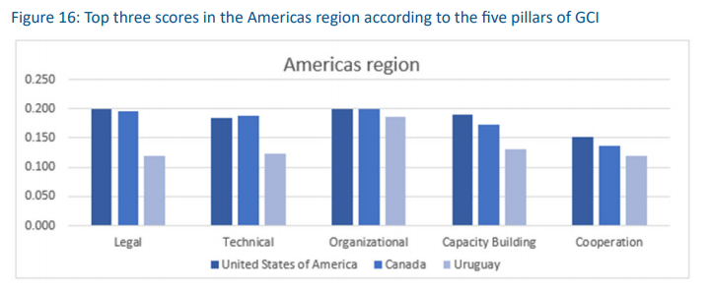
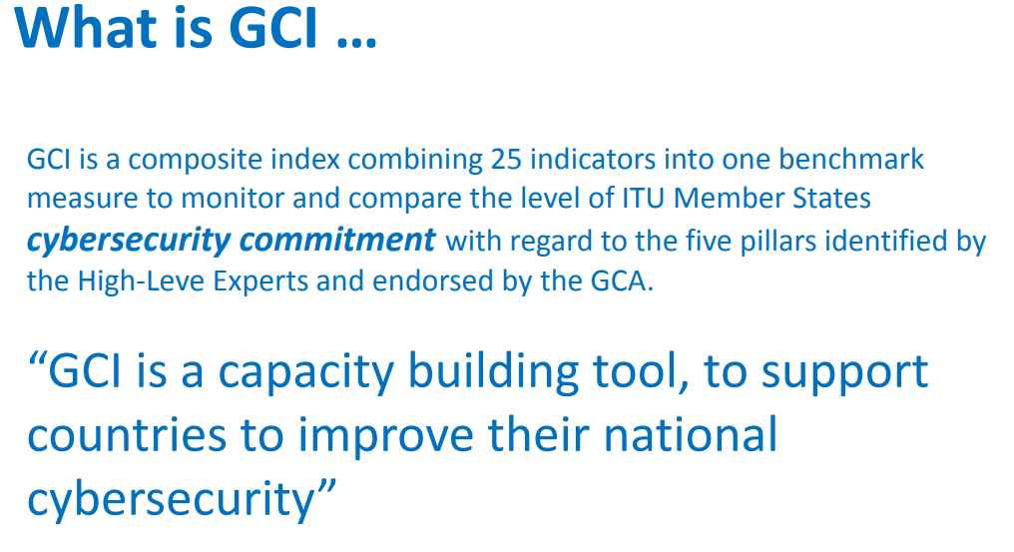
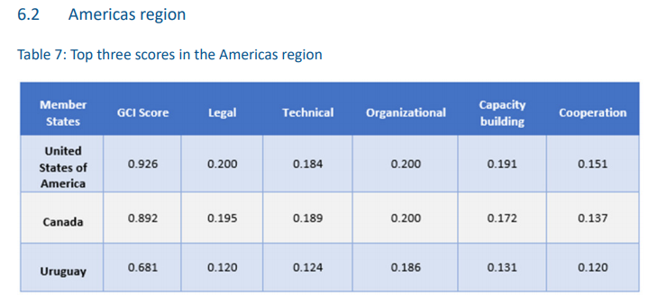
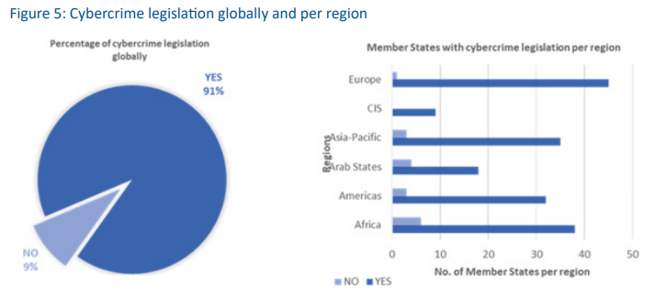
Global Cybersecurity Index
https://www.itu.int/en/itu-d/cybersecurity/pages/global-cybersecurity-index.aspx

Slide 26
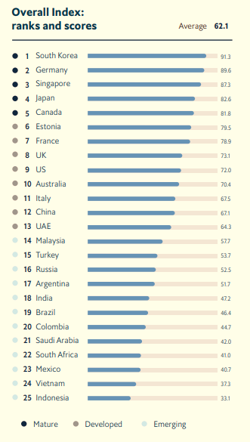
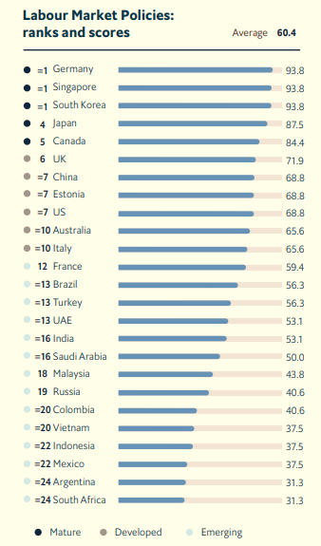
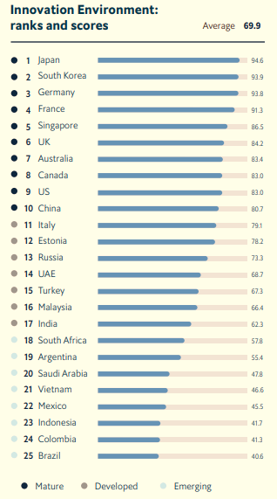
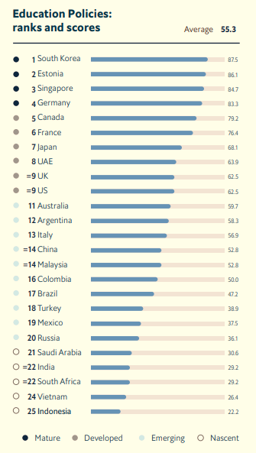
Automation readiness index
https://www.automationreadiness.eiu.com/

Slide 27
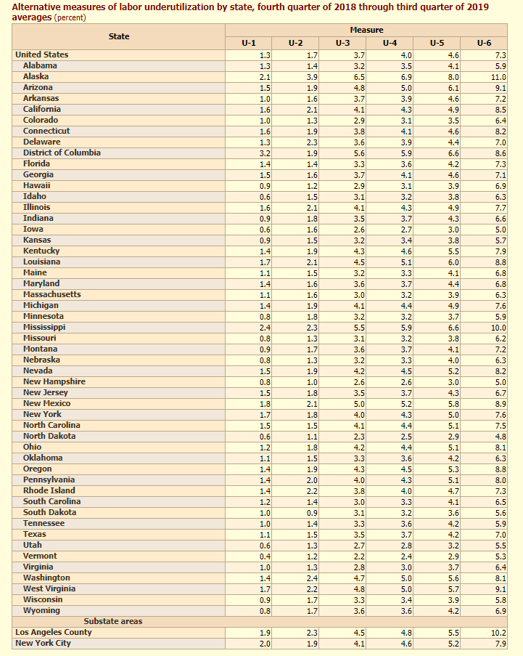
Bureau of labor Statistics
U-1, persons unemployed 15 weeks or longer, as a percent of the civilian labor force;
U-2, job losers and persons who completed temporary jobs, as a percent of the civilian labor force;
U-3, total unemployed, as a percent of the civilian labor force (this is the definition used for the official unemployment rate);
U-4, total unemployed plus discouraged workers, as a percent of the civilian labor force plus discouraged workers;
U-5, total unemployed, plus discouraged workers, plus all other marginally attached workers, as a percent of the civilian labor force plus all marginally attached workers; and
U-6, total unemployed, plus all marginally attached workers, plus total employed part time for economic reasons, as a percent of the civilian labor force plus all marginally attached workers.
https://www.bls.gov/lau/stalt.htm

Slide 28
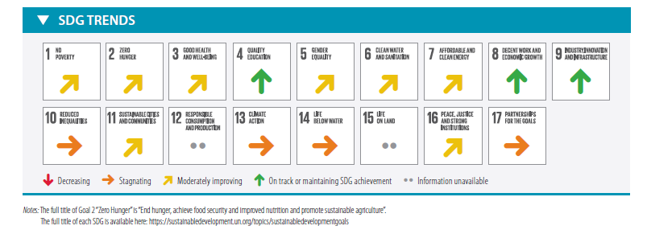
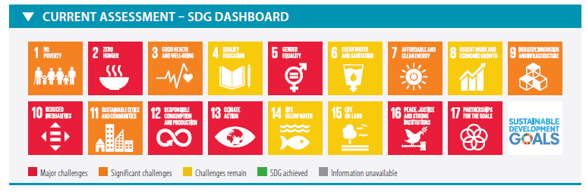
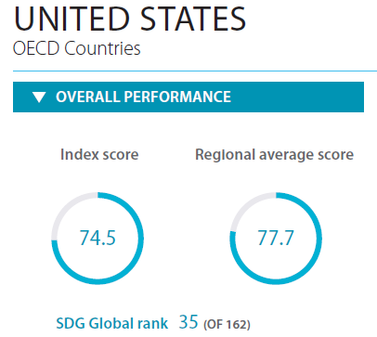
Sustainable Development Goals (SDG)
https://sustainabledevelopment.un.org/
https://sustainabledevelopment.un.org/content/documents/24797GSDR_report_2019.pdf
https://github.com/sdsna/2019GlobalIndex/blob/master/country_profiles/United%20States_SDR_2019.pdf

Slide 29
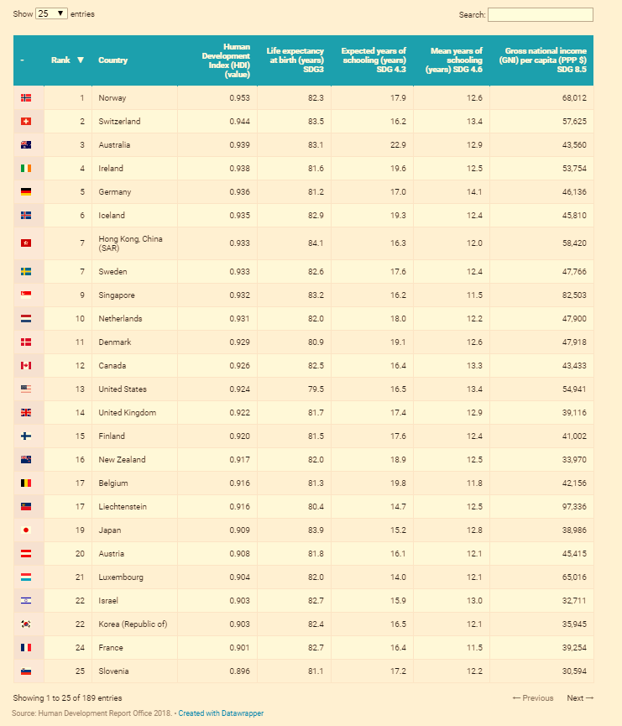
Human Development Index
http://hdr.undp.org/en/composite/gii
http://hdr.undp.org/sites/default/files/hdr2018_technical_notes.pdf

Slide 30
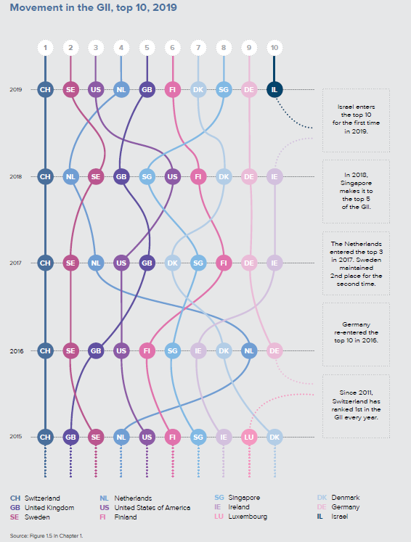
Global Innovation Index
https://www.globalinnovationindex.org/Home

Slide 31
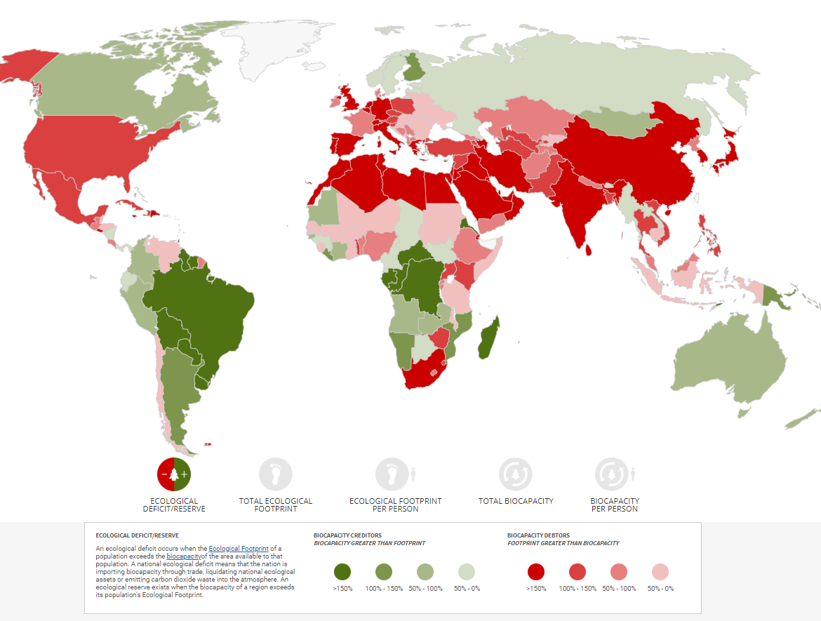
Global Footprint Network
https://www.footprintnetwork.org/
Measure what you treasure
Open Data Platform: https://data.footprintnetwork.org/?_ga=2.157402106.1303688745.1573083628-2029074581.1573083628#/

Slide 32
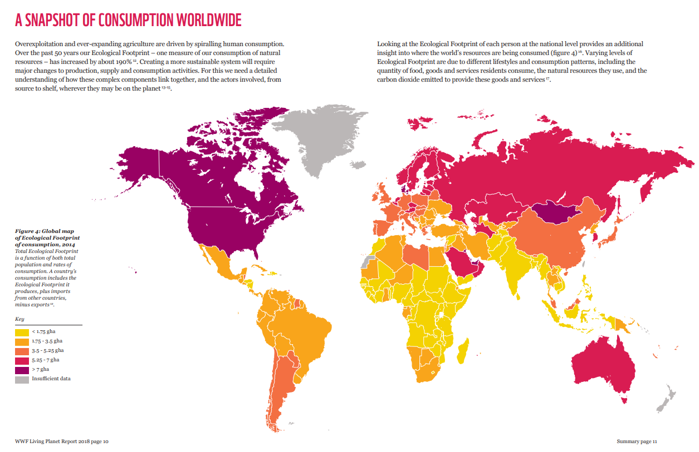
Living Planet Report
https://wwf.panda.org/knowledge_hub/all_publications/living_planet_report_2018/
https://www.footprintnetwork.org/content/documents/WBCSD_SLWGUS15.pdf

Slide 33
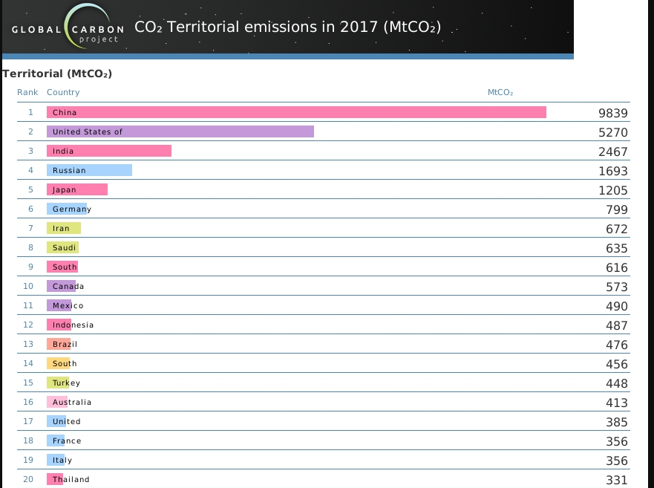
Global Carbon ATlas
http://www.globalcarbonatlas.org/en/CO2-emissions

Slide 34
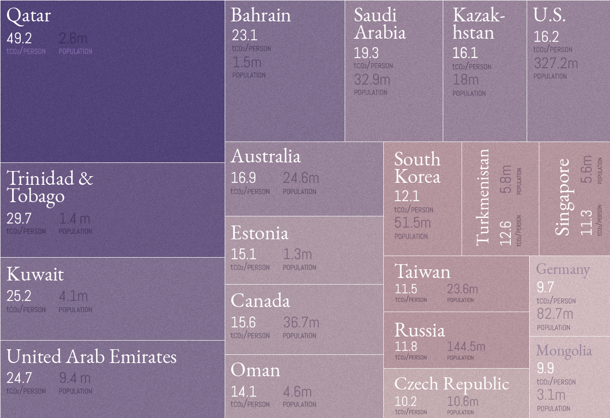
Change the Perspective – the fact looks different

Slide 35
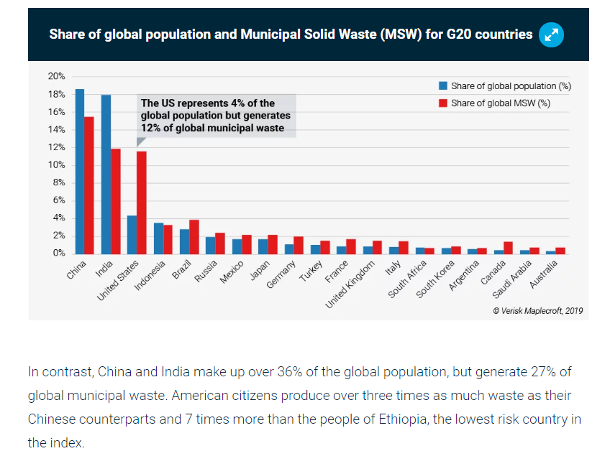
Waste atlas
http://www.atlas.d-waste.com/
Waste generation and recycling indices: https://www.maplecroft.com/insights/analysis/us-tops-list-of-countries-fuelling-the-mounting-waste-crisis/

Slide 36
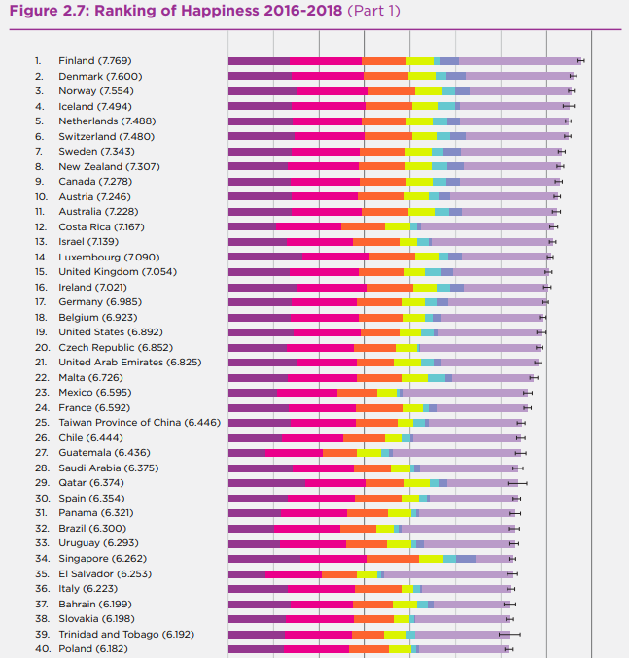

World Happiness Index
https://worldhappiness.report/ed/2019/
https://worldhappiness.report/faq/

Slide 37

Skills of the future!
https://www.weforum.org/agenda/2018/09/future-of-jobs-2018-things-to-know/
http://www3.weforum.org/docs/WEF_Future_of_Jobs_2018.pdf

Slide 38
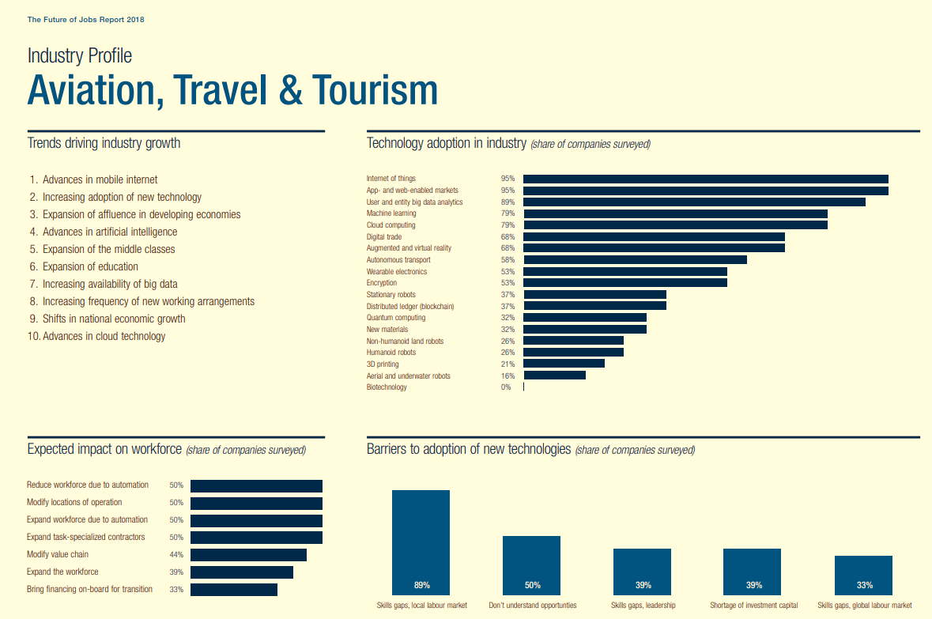
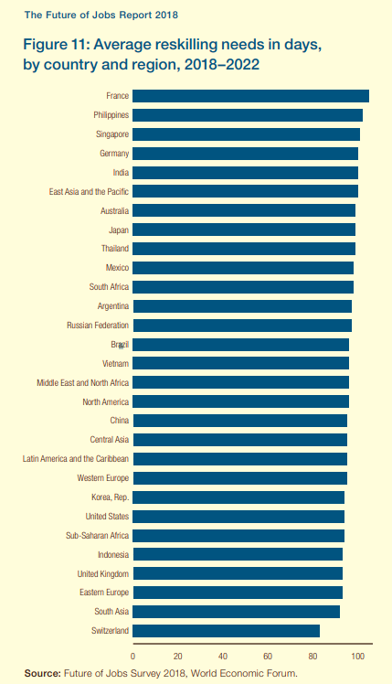

Slide 39
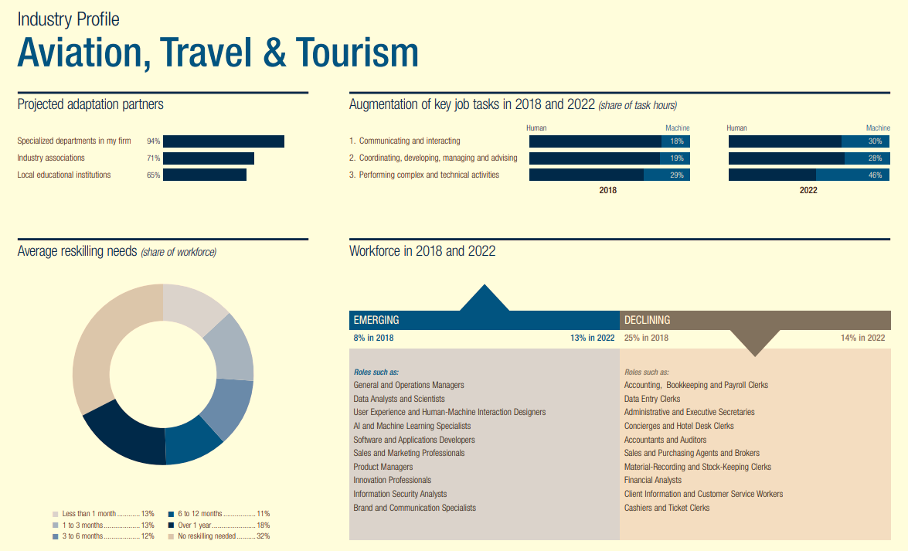

Slide 40
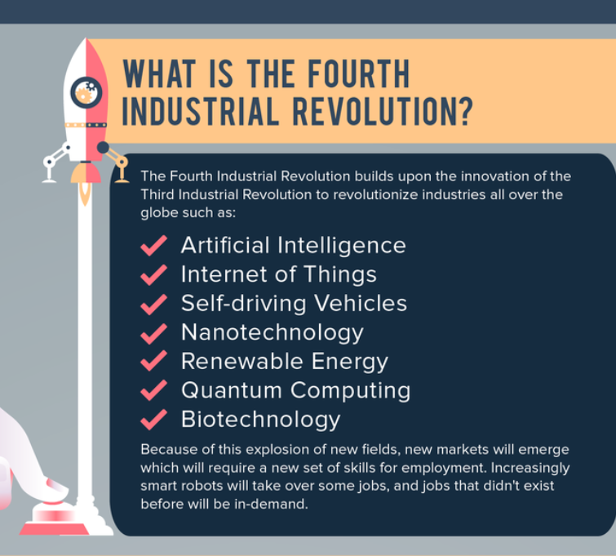
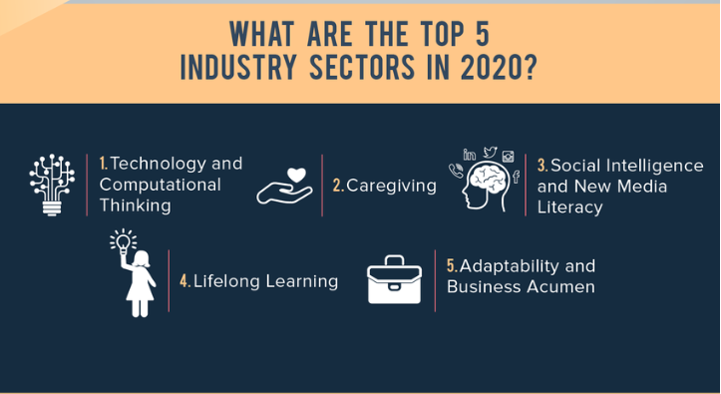
Ready for future?
https://www.weforum.org/agenda/2018/07/the-skills-needed-to-survive-the-robot-invasion-of-the-workplace

Slide 41
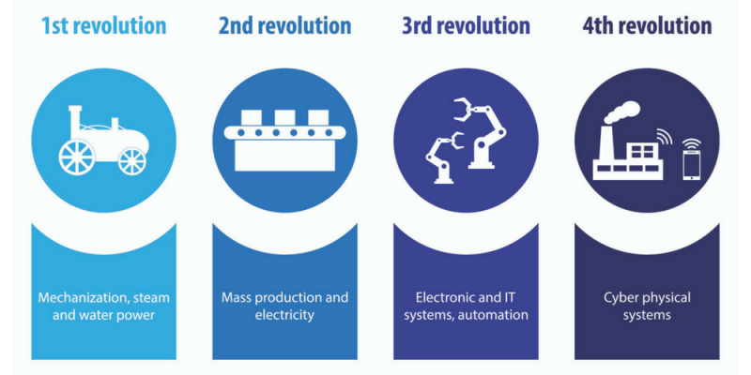

Slide 42
Inequality, Economics, Poverty,
World Inequality Report https://wir2018.wid.world/
Gini Index
Global Multidimensional Poverty Index: http://hdr.undp.org/en/2019-MPI
https://ophi.org.uk/multidimensional-poverty-index/
Harvard Atlas of Economic Complexity: http://atlas.cid.harvard.edu/
Global competitiveness index: https://www.weforum.org/reports/how-to-end-a-decade-of-lost-productivity-growth

Slide 43
Cyber, and Security Reports
Internet Security Threat Report: https://www.symantec.com/security-center/threat-report
Data Breach Investigations Report – Verizon: https://enterprise.verizon.com/resources/reports/dbir/
Cyber Incidents and Breach Trends – The Internet Society: https://www.internetsociety.org/resources/ota/2019/2018-cyber-incident-breach-trends-report/
Internet Health Report – Mozilla: https://blog.mozilla.org/blog/2019/04/23/its-complicated-mozillas-2019-internet-health-report/

Slide 44
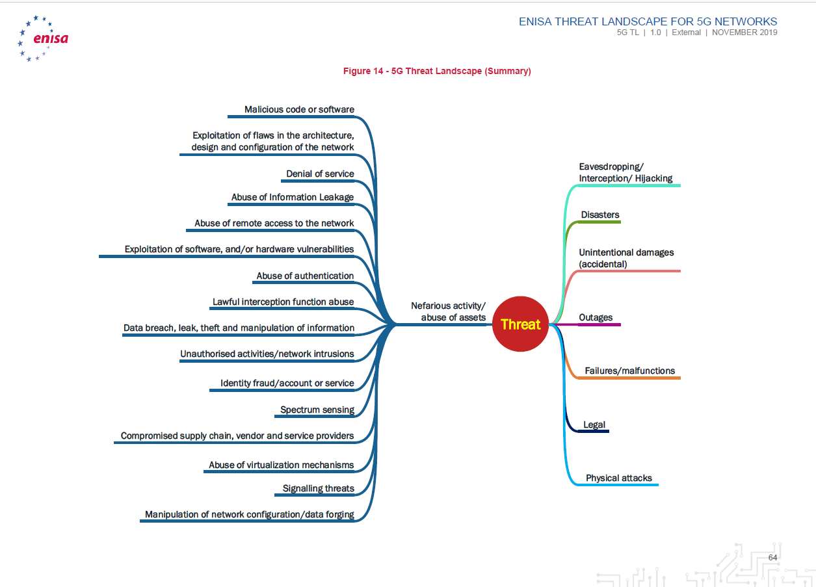
https://www.enisa.europa.eu/publications/enisa-threat-landscape-for-5g-networks

Slide 45
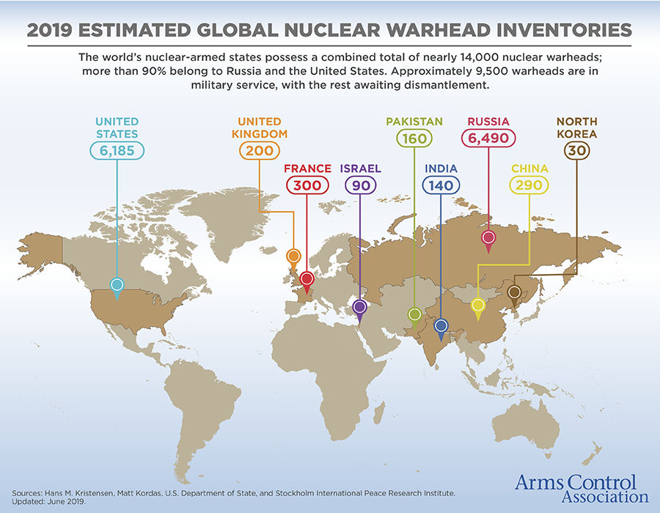
Nuclear Weapons: Who has what at a glance
https://www.armscontrol.org/factsheets/nuclearweaponswhohaswhat

Slide 46
Think Tanks and International ORganisations
Worldbank
https://data.worldbank.org/
Statista
https://www.statista.com/statistics/271496/global-market-share-held-by-smartphone-vendors-since-4th-quarter-2009/
Oxfam
https://www.oxfamamerica.org/explore/issues/
US AID
https://explorer.usaid.gov/

Slide 47
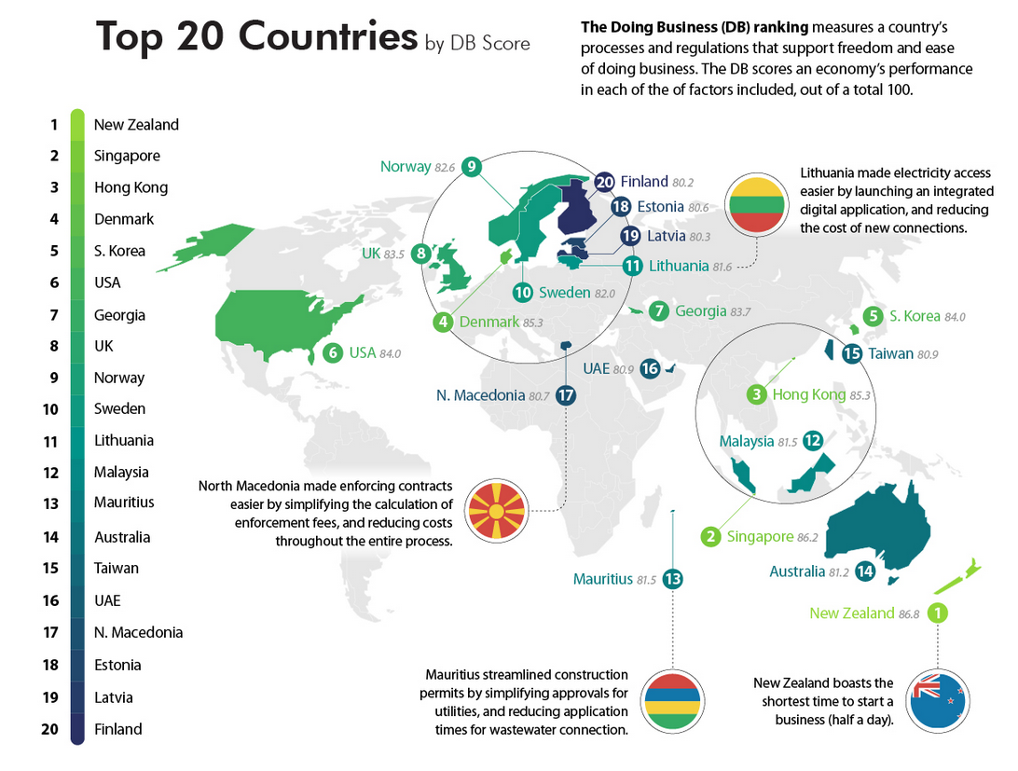
Visual capitalist
https://www.visualcapitalist.com/

Slide 48
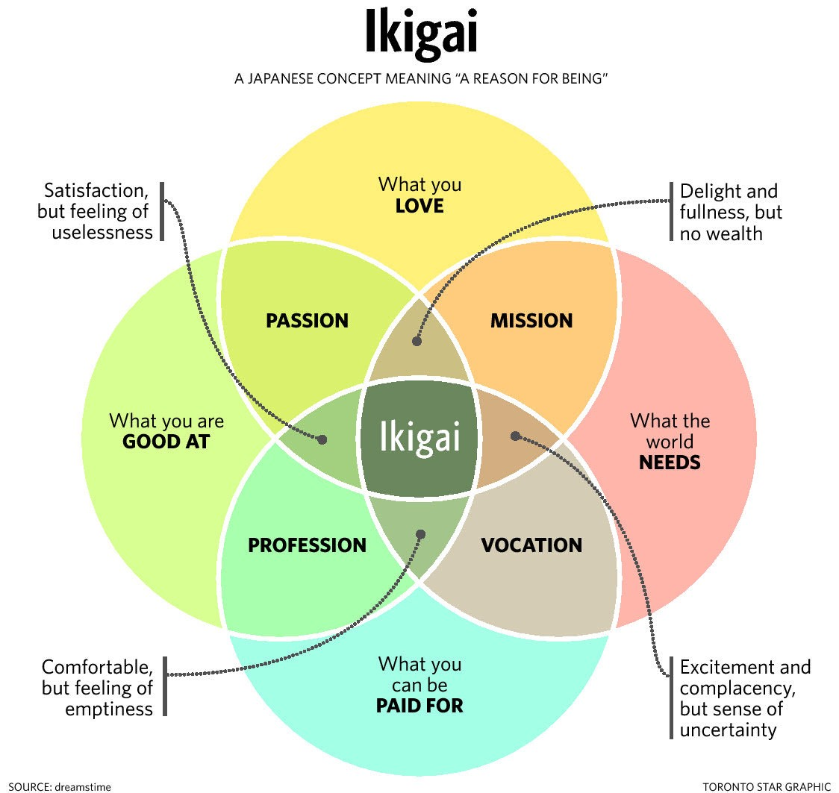
Now measure up yourself!
https://medium.com/org-hacking/when-do-you-feel-ikigai-35e310269cb9
https://medium.com/thrive-global/ikigai-the-japanese-secret-to-a-long-and-happy-life-might-just-help-you-live-a-more-fulfilling-9871d01992b7
A Fun Quiz – will need about 20 minutes!
https://ikigaitest.com/

Slide 49
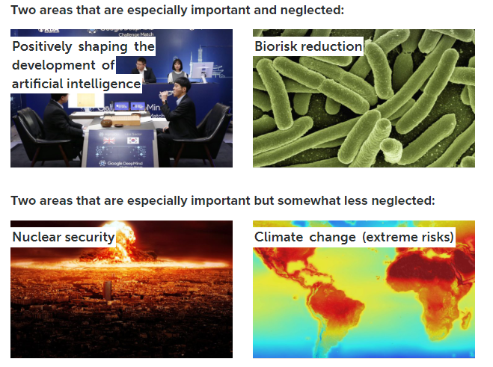


How to find problems that I can solve?
https://80000hours.org/key-ideas/

Slide 50
Some well-known consultancies reports
McKinsey
Accenture
PWC
Deloitte
EY
KPMG

Slide 51

How to check media Bias
https://www.allsides.com/media-bias/media-bias-ratings?field_featured_bias_rating_value=All&field_news_source_type_tid[1]=1&field_news_source_type_tid[2]=2&field_news_source_type_tid[3]=3

Slide 52

Finally!

Slide 53
We can't be neutral, bias is inherent, but we can become aware and let people know our stance before we pass a judgement
Detect generalizing words such as “all” “most”, country-specific such as “Americans like Iced Tea” etc., in reports.
Cross-Check; Challenge your own Bias!
Use the thumb-rule 3 - to verify i.e., at least 3 unique/unrelated sources

Slide 54
Information
Check the time horizon – how long is the information valid for?
Check the timeline – when was this information produced?
Choose social media outlets wisely based on purpose
Facebook
linkedIn
WhatsApp
Keep it clean – footprint is permanent, and it matters
Authenticity
Integrity
Privacy
Cite or Reference it!

